Slide 1
DATABASE

Slide 2
Introduction
Database has become an essential component of life in modern days
Eg. Airplane reservation, bank deposit or withdraw, purchase book online,etc..
All these activities involve some interaction with the database
In general, Database is a collection of related data. It can be generated & maintained manually or it may be computerised.

Slide 3
Introduction contd…
A database management system (DBMS) is a collection of programs that enables users to create and maintain a database.
DBMS includes the following steps:
Defining (specifying data types,structure,constraints.)
Constructing (process of storing the data on storage medium)
Manipulating(querying the database to retrieve specific data , updating the database to reflect changes)
Sharing ( multiple users & programs access data simultaneously)

Slide 4
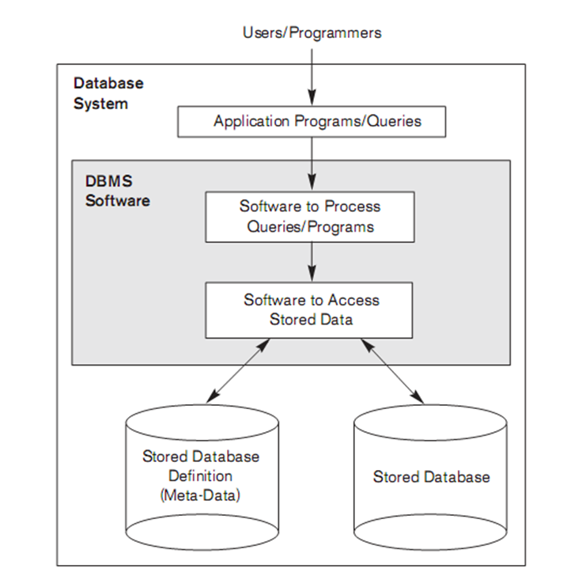
Database system environment

Slide 5
Characteristic of Database Approach
Database Approach Vs Traditional File Processing
In traditional file processing, each user maintains separate files of record.
They have to maintain a separate copy of record
i.e redundant effort in maintaining the record
In database approach, a single repository maintains data that is defined once and then accessed by various users

Slide 6
Characteristics contd…
Self-Describing Nature of a Database System
a complete definition or description of the database structure and constraints is stored in a catalog called meta-data.
DBMS software package is not written for a specific database

Slide 7
Characteristics contd..
Support of Multiple Views of the Data
A database typically has many users, each of whom may require a different perspective or view of the database. A view may be a subset of the database or it may contain virtual data that is derived from the database files but is not explicitly stored

Slide 8
Sharing of Data and Multiuser Transaction Processing
A fundamental role of multiuser DBMS software is to ensure that concurrent transactions operate correctly and efficiently
The DBMS must include concurrency control software to ensure that several users trying to update the same data do so in a controlled manner so that the result of the updates is correct

Slide 9
Advantages of dbms
Controlling Redundancy
Restricting Unauthorized Access
Providing Storage Structures and Search techniques for Efficient Query Processing
Providing Backup and Recovery
Providing Multiple User Interfaces
Representing Complex Relationships among Data

Slide 10
Advantages contd..
Enforcing Integrity Constraints

Slide 11
Problems In File Processing approach
Data redundancy and inconsistency
Same information may be duplicated in several places.
All copies may not be updated properly
Difficulty in accessing data
May have to write a new application program to satisfy an unusual request.
E.g. find all customers with the same postal code.
Could generate this data manually, but a long job...
Data isolation
Data in different files.
Data in different formats.
Multiple users
Want concurrency for faster response time.
Need protection for concurrent updates.
E.g. two customers withdrawing funds from the same account at the same time. account has Rs. 500 in it, and they withdraw Rs. 100 and Rs. 50. The result could be Rs. 350, Rs.400 or Rs. 450 if no protection

Slide 12
Problems In File Processing approach
Security problems
Every user of the system should be able to access only the data they are permitted to see.
E.g. payroll people only handle employee records, and cannot see customer accounts; tellers only access account data and cannot see payroll data.
Difficult to enforce this with file processing programs.
Integrity problems
Data may be required to satisfy constraints.
E.g. no account balance below Rs 25.00.
Again, difficult to enforce or to change constraints with the file-processing approach.
These problems and others led to the development of database management system.

Slide 13
Data Abstraction
The major purpose of a database system is to provide users with an abstract view of the system.
The system hides certain details of how data is stored and maintained
Complexity is hidden from database users.
These are the levels of abstraction
A) Physical Level
B) Conceptual Level
C) View Level

Slide 14
Data abstraction cont..
A) Physical Level
Lowest level of abstraction.
How the data are stored.
E.g. index, B-tree, hashing
Complex low-level structures described in detail.
B) Conceptual Level
Next highest level of abstraction.
Describes what data are stored.
Describes the relationships among data.
Database administrator level.

Slide 15
Data Abstraction contd…
C) View Level
Highest level.
Describes part of the database for a particular group of users.
Can be many different views of a database.
E.g. tellers in a bank get a view of customer accounts, but not of payroll data.

Slide 16
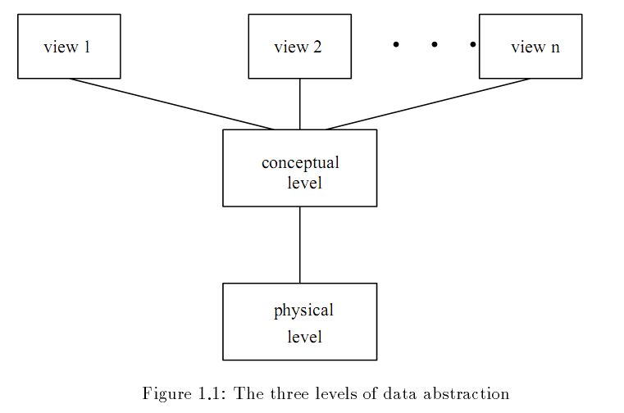

Slide 17
Data Modelling
It is the process of creating a representation of the structure of the database. The result of the process is a “data model”.
Data models are a collection of conceptual tools for describing data, data relationships, data semantics and data constraints
So a data model
Identifies what is to be stored in the database.
It also defines structure and relationship
It is the basis for all subsequent database development

Slide 18
Data Model cont..
There are different groups:
A) Object-based Logical Models.
Describe data at the conceptual and view levels.
Over 30 models including
Entity Relationship model (ER model)
Object Oriented model
Binary model
Semantic data model, etc.
B)Physical Data Models
Are used to describe data at the lowest level.
Very few models, e.g.
Unifying model.
Frame memory.
We will only cover ER Modelling
We will not cover physical models

Slide 19
E-R Model
The entity-relationship model is based on a perception of the world as consisting of a collection of basic objects entities and relationships among these objects.
An entity is a distinguishable object that exists.
Each entity has associated with it a set of attributes describing it. E.g. number and balance for an account entity.
A relationship is an association among several entities.
e.g. A cust acct relationship associates a customer with each account he or she has.
The set of all entities or relationships of the same type is called the entity set or relationship set.

Slide 20
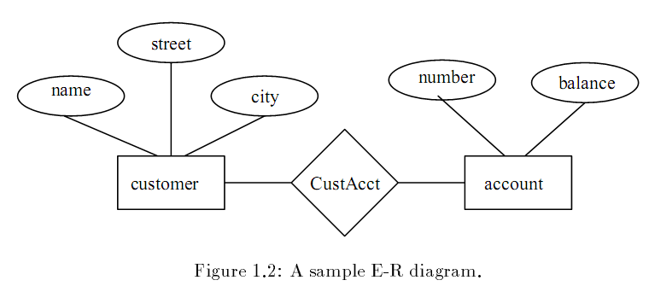
E-R Model contd..

Slide 21
Instances and Schemes
Database changes over time
The information in a database at a particular point in time is called an instance of the database.
The overall design of the database is called the database scheme.
Analogy with programming language:
Data type definition – scheme
Value of a variable – instance
There are several schemes, corresponding to levels of abstraction:
Physical scheme
Conceptual scheme

Slide 22
Data independence
The ability to allow users to take a logical view of the database which is independent of the way that the data is stored.
The ability to modify a scheme definition in one level without affecting a scheme definition in a higher level is called data independence.

Slide 23
Summary of previous lect.
Advantage
Data Abstraction
Data Modelling
Instance & Schema

Slide 24
Data independence
The ability to modify a scheme definition in one level without affecting a scheme definition in a higher level is called data independence.
They are of 2 types:
Physical Data Independence
The ability to modify the physical scheme without causing application programs to be rewritten
Modifications at this level are usually to improve performance

Slide 25
Data independence cont..
Logical Data Independence
The ability to modify the conceptual scheme without causing application programs to be rewritten
Usually done when logical structure of database is altered
harder to achieve as the application programs are usually heavily dependent on the logical structure of the data

Slide 26
Database Languages
Database system provide
Data Definition Language (DDL)
Specify database schema
Data Manipulation Language (DML)
Database queries & updates
DDL & DML are not two separate languages, they are part of a single database language
SQL (widely used database language)

Slide 27
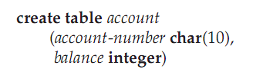
DDL Example…
Execution of the above DDL statement creates the account table

Slide 28
Data Manipulation Language
Data Mainpulation is:
Retrieval , Insertion , Deletion ,Modification
DML is a language which enables users to access and manipulate data
A query is a statement requesting the retrieval of information.
The portion of DML that involves information retrieval is called query language
DML & query language are often used simultaneouly

Slide 29

DML Example…
This query in SQL Language finds the name of the customer whose customer-id is specified after = equal sign.

Slide 30
What’s Next!
Database Administrator
Database Users
Overall System Architecture….

Slide 31
Database Manager
A program module which provides the interface between the low-level data stored in the database and the application programs and queries submitted to the system.
Databases typically require lots of storage space gigabytes. This must be stored on disks. Data is moved between disk and main memory MM as needed.

Slide 32
Database Manager cont..
Database Manager module is responsible for
Interaction with the file manager
Storing raw data on disk using file system
Integrity enforcement
Do not violate consistency constraints
Security enforcement
Ensure user access to information they are permitted to
Backup and Recovery
Detecting failures due to power failure, disk crash,etc and restoring the database to its state before the failure
Concurrency control
Preserving data consistency when there are concurrent users

Slide 33
Database Administrator
Is person having central control over data and program accessing that data
Duties of administrator
Database design
Scheme definition
User authorization

Slide 34
Database Users
Application programmers
Computer professionals
Interacts with the system through programming commonly using host language (java,c#,etc)
Host language compiler generates object code
Sophisticated users
Interacts with the system without writing programs
Requests by writing queries in a database query language
Query submitted to query processor that breaks DML statement down into instructions for database manager module

Slide 35
Database Users contd…
Specialized users
Are sophisticated users writing special database application programs.
Complex database systems (audio/video), Knowledge-based experts systems, etc
Naive users
Unsophisticated users who interacts with the system by using permanent application programs (eg. ATM)

Slide 36
Overall System Structure
File Manager
Allocation of disk space & data structure on disk
Database manager
Interface between low-level data & application program and queries
Query Processor
Translates statements in a query language to low-level instruction that db manager understands
DML precompiler
Converts DML statement in application program to normal procedure calls in host language

Slide 37
Overall System Structure cont..
DDL Compiler
Converts DDL statements to a set of tables containing metadata stored in a data dictionary
Data Files – stores the data itself
Data Dictionary – stores information about the structure of the database. It is used heavily
Indices – provides fast access to data items holding particular values.

Slide 38
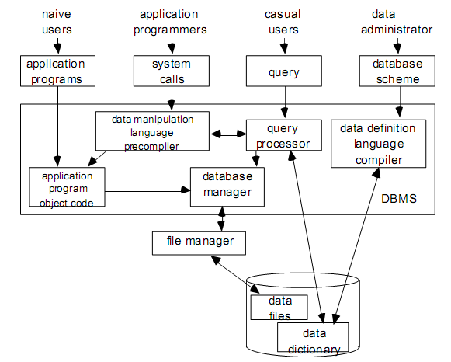
Overall System Structure

Slide 39
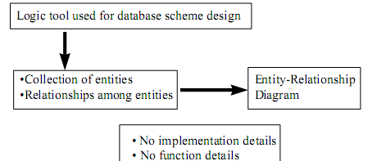
Entity-Relationship Model
E-R Model views the real world as a set of basic objects (entities) and relationship among these objects.
Represents overall logical structure of the DB

Slide 40
Entity
An Entity is an object (something) that exists and is distinguishable from other objects (things)
Independent existence
Described by its attributes (set of properties)
Determined by particular value of its attributes
Can be concrete or abstract
Example
A book
Title=“Database system concept”,pages=820,ISBN=xxxxxxxx
A person
Name=“Suman Ghimire”,age=28,Citizen No=xxxxxx
A holiday
Name=“Christmas”,date=December 25

Slide 41
Entity Set
An entity set is a set of entities of the same type; entities that share the same properties
Example
A set of books
A set of people taking DBMS
Entity set need not be disjoint.
For eg. The entity set employee all employees of a bank an the entity set customer all customers of the bank may have members in common.

Slide 42
Attributes
An entity is represented by a set of attributes i.e descriptive properties possessed by all members of an entity set
Example
Student (StudentID,Name,Address,Class,Grade)
Course(Number,Title,Classroom,instructor)
Domain
Domain of an attribute is a set of permitted values for each attribute
Example
Attribute Age is a number between 0 and 200
Color is one of { blue,green,black,…)

Slide 43
Attribute types
Single value vs Multi valued
Single : Social Insurance Number, student number
Multi: Telephone Numbers, Lectures of a course,..
Simple vs Composite
Composite: Address = Apt No, Street, City, Postal Code
Null Value
No corresponding values (contain no value)
Stored vs Derived
Stored: Individual mark of a student
Derived: Overall grade of a student

Slide 44
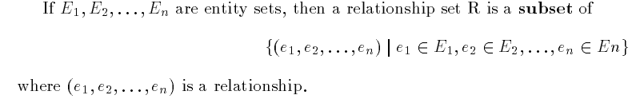
Relationships & Relationship Sets
A relationship is an association between several entities.
A relationship set is a set of relationships of the same type.
Eg. CustAcc relationship between customer & Account
CustAcc is a subset of all possible customer & account pairings

Slide 45
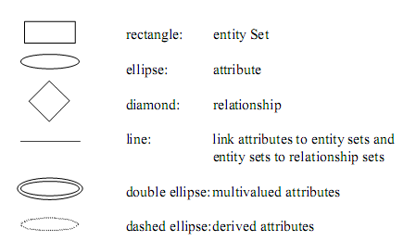
Notation

Slide 46
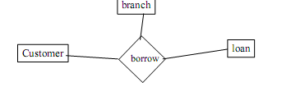
Degree of relationship set
Refers to the number of entity sets that participate in a relationship set
Relationship that involve two entity sets are called binary
Relationship may involve more than 2 entity sets
The entity set customer, loan and branch may be linked by a ternary relationship.

Slide 47
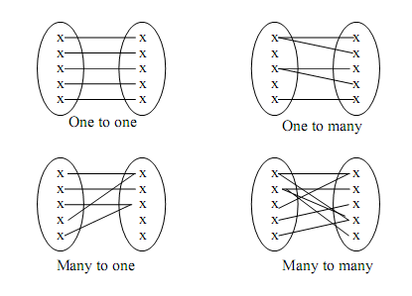
Mapping cardinalities
Express the number of entities to which another entity can be associated via a relationship set
One to one
One to many
Many to one
Many to many

Slide 48
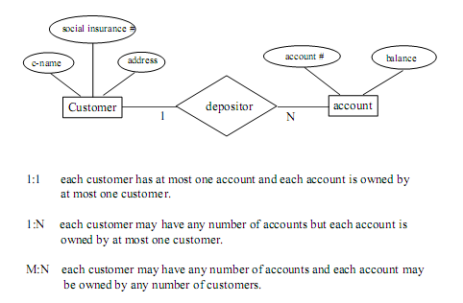

Slide 49
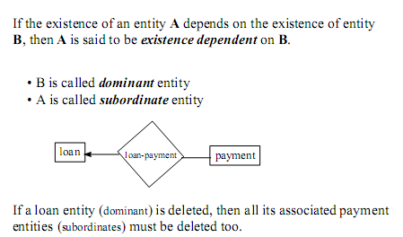
Existence Dependencies

Slide 50

Entity set Keys
For eg. Entity set Customer, customer-name & SIN is a super key.
Customer name alone is not, as two customers could have same name
In above example SIN is a candidate key, as it is minimal, and uniquely identifies a customer entity

Slide 51
Primary key is a candidate key chosen by the db designer to identify entities in an entity set.
Weak Entity Sets
An entity set that does not have a primary key is referred to as a weak entity set.
Strong Entity Set
One that does have a primary key is called strong entity set

Slide 52
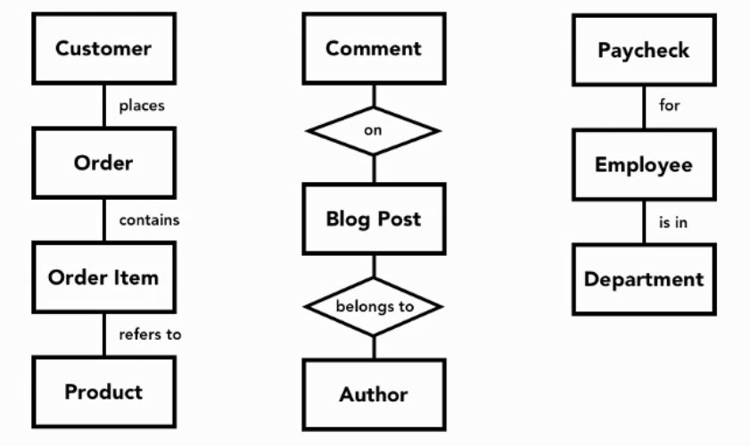
Reducing ER Diagram to table..

Slide 53
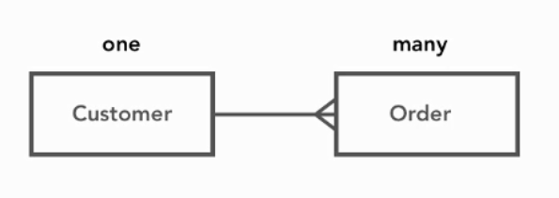
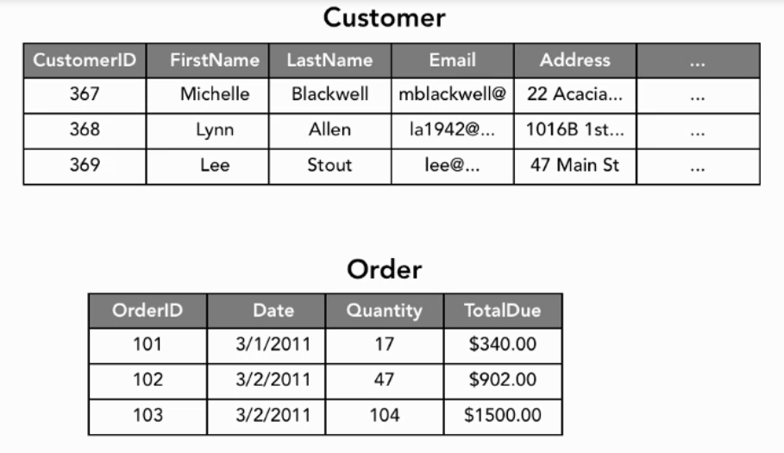

Slide 54
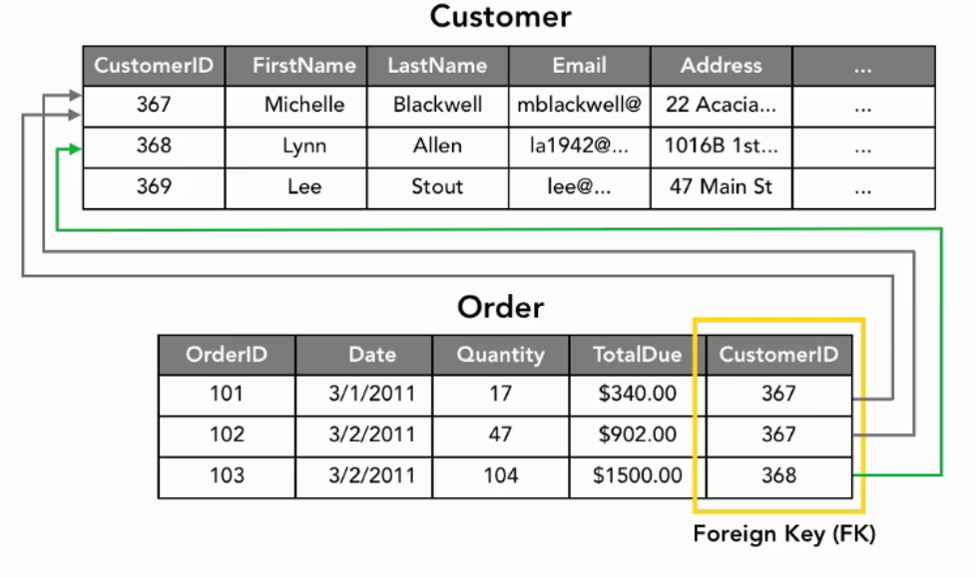

Slide 55
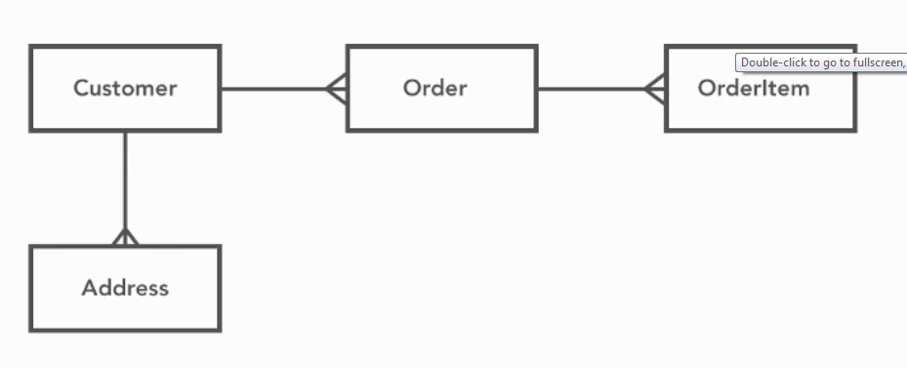
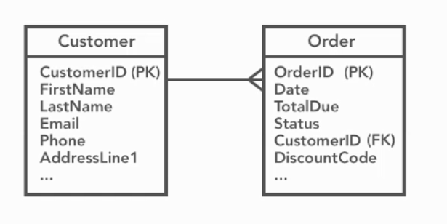

Slide 56
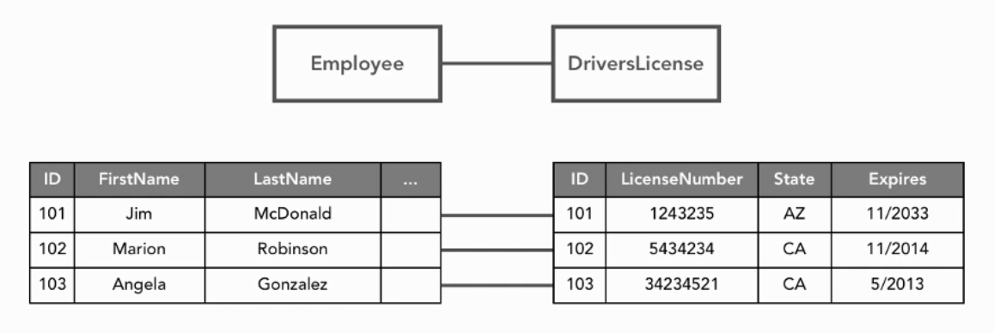
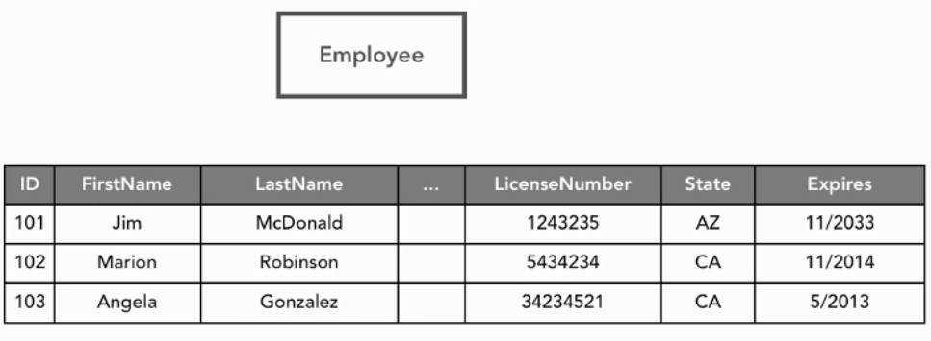
1 to 1

Slide 57
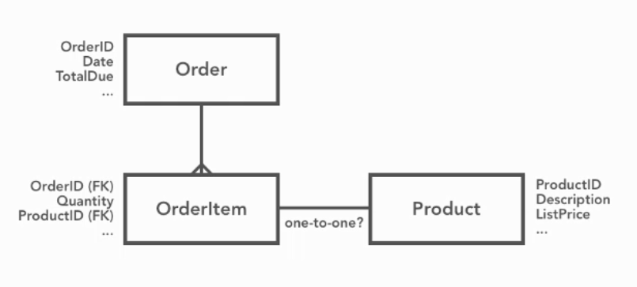
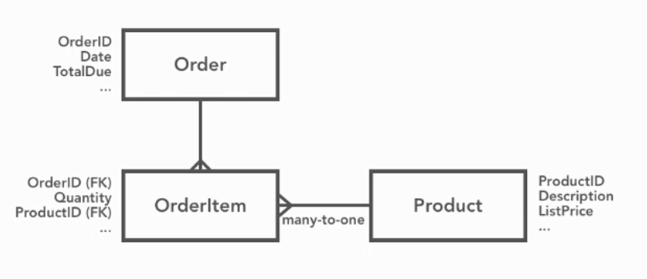

Slide 58
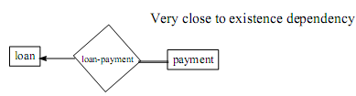
Total Participation
The participation of an entity set E in a relationship R is said to be total if every entity in E participates in at least one relationship in R.
If only some entities in E participate in relationships in R, the participation on entity set E in relationship R is said to be partial.
Notation in E-R diagram: double lines indicate total participation

Slide 59
Extended E-R Features
Specialization
Generalization
Attribute inheritance
Aggregation

Slide 60
Specialization
An entity set may contain subgroupings of entities
Such Entity Set is a high-level entity set that can be broken down into one or more lower-level entity set.
Example:
Course => undergraduate course/ graduate course/ or CMPT/ENG
Account => saving account/ fixed deposit account

Slide 61
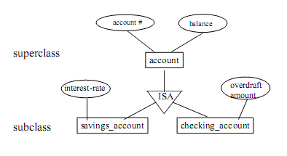
An entity type E1 is a specialization of another entity type E2 if E1 has the same properties of E2 and perhaps even more
E1 IS-A E2
specialization is depicted by a triable labeled ISA.

Slide 62
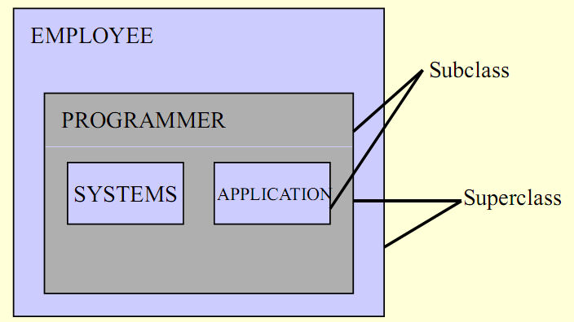
Analogy to super class & sub class
Systems and Application are Subclasses of Programmer

Slide 63
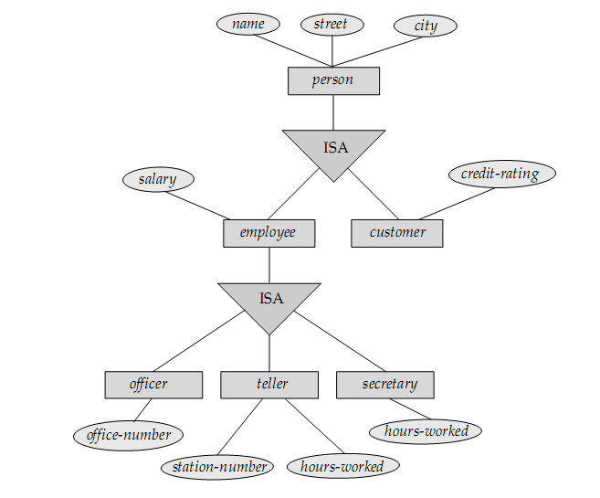

Slide 64
Generalization
Specialization => top-down design
Generalization => bottom-up design
Abstracting the common properties of two or more entities to produce a “higher-level” entity.

Slide 65
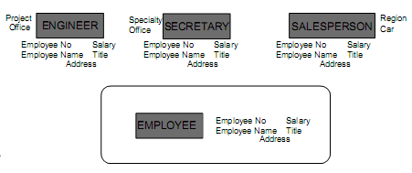
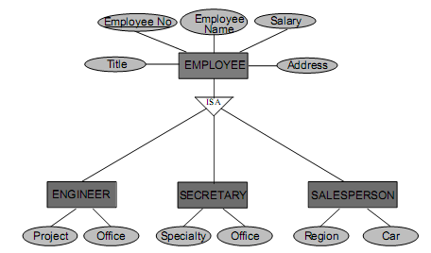

Slide 66
Create Table
CREATE TABLE Persons ( Id int NOT NULL PRIMARY KEY, LastName nvarchar(255) NOT NULL, FirstName nvarchar(255), Address nvarchar(255), City nvarchar(255) )
NOT NULL constraint enforces a column to NOT accept NULL values.

Slide 67
Primary key contraint name (Multiple columns)
CREATE TABLE Persons ( Id int NOT NULL, LastName varchar(255) NOT NULL, FirstName varchar(255), Address varchar(255), City varchar(255), CONSTRAINT pk_PersonID PRIMARY KEY (Id,LastName) )

Slide 68
SQL PRIMARY KEY Constraint on ALTER TABLE
ALTER TABLE Persons ADD PRIMARY KEY (Id)
ALTER TABLE Persons ADD CONSTRAINT pk_PersonID PRIMARY KEY (Id,LastName)

Slide 69
DROP a PRIMARY KEY Constraint
ALTER TABLE Persons DROP CONSTRAINT pk_PersonID

Slide 70
Foreign Key
CREATE TABLE Orders ( Id int NOT NULL, OrderNo int NOT NULL, PId int, PRIMARY KEY (Id), CONSTRAINT fk_PerOrders FOREIGN KEY (PId) REFERENCES Persons(Id) )

Slide 71
CREATE TABLE Orders ( Id int NOT NULL PRIMARY KEY, OrderNo int NOT NULL, PId int FOREIGN KEY REFERENCES Persons(Id) )

Slide 72
ALTER TABLE Orders ADD CONSTRAINT fk_PerOrders FOREIGN KEY (PId) REFERENCES Persons(Id)
ALTER TABLE Orders DROP CONSTRAINT fk_PerOrders

Slide 73
Sys object
sp_help “Table-Name”
SELECT * FROM sys.key_constraints
SELECT * FROM sys.tables
SELECT * FROM sys.key_constraints
WHERE [type] = 'PK‘ AND [parent_object_id] = Object_id('dbo.iProductCategory');

Slide 74
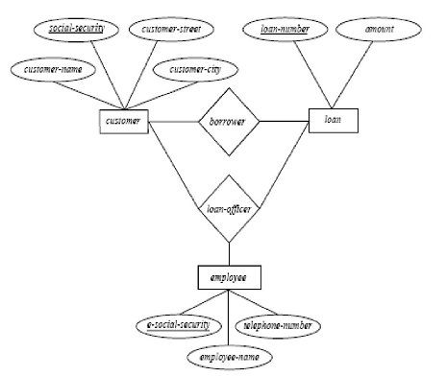
Aggregation

Slide 75
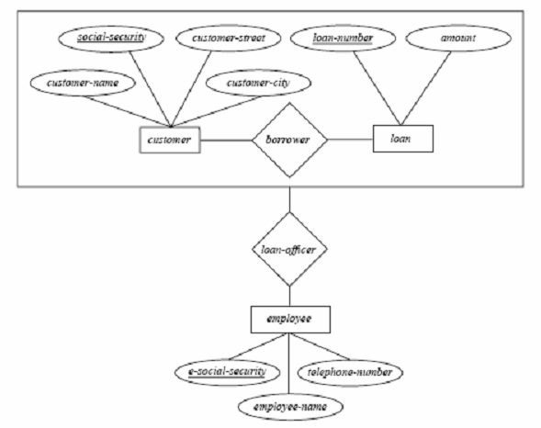
Relationship sets borrower and loan-officer represent the same information
- Eliminate this redundancy via aggregation as shown in Figure

Slide 76
Without introducing redundancy, the above diagram represents that:
A customer takes out a loan
An employee may be a loan officer for a customer-loan pair
Points in Aggregation
– Treat relationship as an abstract entity.
– Allows relationships between relationships.
– Abstraction of relationship into new entity.

Slide 77
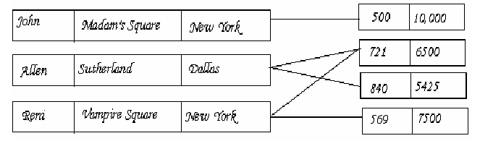
Network Model
Data are represented by collections of records.
Relationships among data are represented by links.
Organization is that of an arbitrary graph and represented by Network diagram.

Slide 78
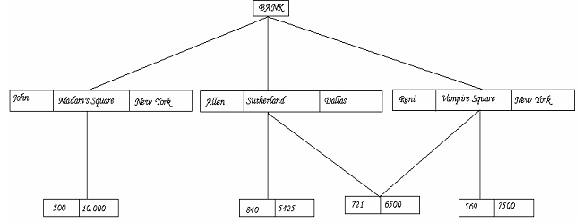
The Hierarchical Model
Similar to the network model and the concepts are derived from the earlier systems. (older models)
Organization of the records is as a collection of trees, rather than arbitrary graphs.

Slide 79
In the hierarchical model, a Schema is represented by a Hierarchical Diagram
One record type, called Root, does not participate as a child record type.
Every record type except the root participates as a child record type in exactly one type.
Leaf is a record that does not participate in any record types.
A record can act as a Parent for any number of records.

Slide 80
Class work
Construct an E-R diagram for a car-insurance company whose customers own one or more cars each. Each car has associated with it zero to any number of recorded accidents.
Construct an E-R diagram for a hospital with a set of patients and a set of medical doctors. Associate with each patient a log of the various tests and examinations conducted.

Slide 81
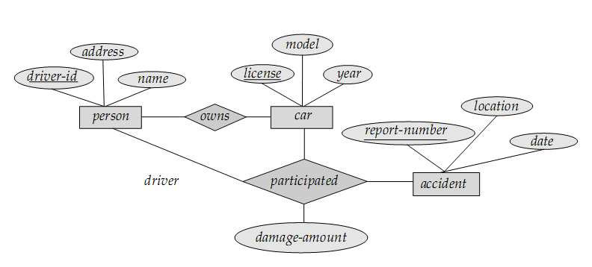
Insurance company

Slide 82
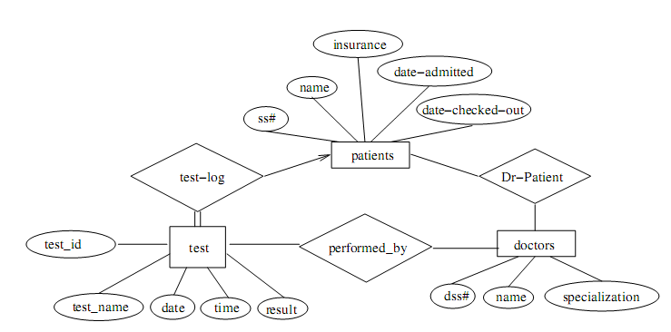
Hospital

Slide 83
Relational Model

Slide 84
Relational Model
The first database systems were based on the network and hierarchical models
Relational Model was proposed by Edgar. F. Codd (1923-2003) in the early seventies.
Most of the modern DBMS are relational.
Simple and elegant model with a mathematical basis.
Led to the development of a theory of data dependencies and database design.
Relational algebra operations –
crucial role in query optimization and execution.
Laid the foundation for the development of
Tuple relational calculus and then
Database standard SQL

Slide 85
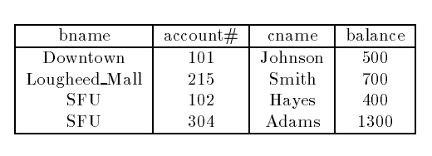
Basic structure
It has four attributes.
For each attribute there is a permitted set of values, called the domain of that attribute.
E.g. the domain of bname is the set of all branch names.
Let D1 denote the domain of bname, and D2, D3 and D₄the remaining attributes' domains respectively.
Then, any row of deposit consists of a four-tuple v₁;v2;v3;v4 where
v₁E D1;v2 E D2;v3 E D3;v4 E D4

Slide 86


In general, deposit contains a subset of the set of all possible rows.
That is, deposit is a subset of D₁ X D2XD3XD4; or; abbreviated to;
In general, a table of n columns must be a subset of
all possible rows
Mathematicians define a relation to be a subset of a Cartesian product of a list of domains
We will use the terms relation and tuple in place of table and row from now on.

Slide 87
let the tuple variable t refer to a tuple of the relation r.
We say t E r to denote that the tuple t is in relation r.
Then t[bname] = t[1] = the value of t on the bname attribute.
So t[bname] = t[1] = “Downtown",
and t[cname] = t[3] = “Johnson".

Slide 88
Relational Moel
Tables are called as relation.
Column headers are known as attributes.
Rows are called as tuples
Relation schema = name(attributes) + other structure information
E.g., keys, other constraints.
Order of attributes is arbitrary, but in practice we need to assume the order given in the relation schema.
Relation instance is current set of rows for a relation schema.
Database schema = collection of relation schemas.

Slide 89
Basic Structure
Formally, given sets D1, D2,... Dn a relation r is a subset of D1x D2x … x Dn .Thus a relation is a set of n-tuples (a1, a2, …, an) where each ai Di
Example: if
customer-name = {Jones, Smith, Curry, Lindsay}
customer-street = {Main, North, Park}
customer-city = {Harrison, Rye, Pittsfield}
Then r = {
(Jones, Main, Harrison),
(Smith, North, Rye),
(Curry, North, Rye),
(Lindsay, Park, Pittsfield)}
is a relation over customer-name x customer-street x customer-city

Slide 90
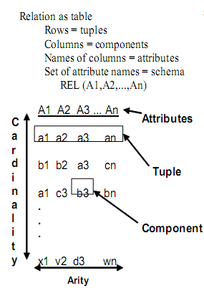
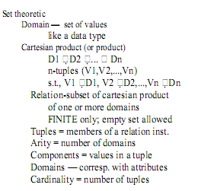

Slide 91
Query Language
is a language in which a user requests information from a database.
These are typically
Procedural, where the user instructs the system to perform a sequence of operations on the database. This will compute the desired information.
Nonprocedural, where the user specifies the information desired without giving a procedure for obtaining the information.
A complete query language also contains facilities to insert and delete tuples as well as to modify parts of existing tuples.

Slide 92
RELATIONAL ALGEBRA
A set of operators (unary and binary) that take relation instances as arguments and return new relations.
Gives a procedural method of specifying a retrieval query.
Forms the core component of a relational query engine.
SQL queries are internally translated into RA expressions.
Provides a framework for query optimization.

Slide 93
RA Operations
Six basic operators are fundamental in relational algebra.
They are
select (σ),
project (π),
cross product (×),
union (⋃),
intersection (∩),
difference (−),
join ( ⋈)
The operators take two or more relations as inputs and give a new relation as a result.

Slide 94
The select Operator
Unary operator.
can be used to select those tuples of a relation that
satisfy a given condition (predicate).
Select is denoted by a lowercase Greek sigma, with the predicate appearing as a subscript.
Notation: σθ ( r )
σ : select operator ( read as sigma)
θ : selection condition
r : relation name
Result: a relation with the same schema as r consisting of the tuples in r that satisfy condition θ

Slide 95

Examples of Select Operator
1. Obtain information about a professor with name “giridhar”
σname = “giridhar” (professor)
2. Obtain information about professors who joined the university between 1980 and 1985
σstartYear ≥ 1980 ^ startYear < 1985 (professor)
3. Suppose there is one more relation, client with the scheme
Client scheme = (cname,banker)
We might write
to find clients who have the same name as their banker.

Slide 96

The Project Operation
Project copies its argument relation for the specified attributes only. Since a relation is a set, duplicate rows are eliminated. Projection is denoted by the Greek capital letter pi.
For example, to obtain a relation showing customers and branches, but ignoring amount and loan,

Slide 97

To get the names of customers having the same name as their bankers,
Think of select as taking rows of a relation, and project as taking columns of a relation.

Slide 98


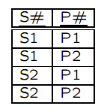
The Cartesian Product Operation
The Cartesian product of two relations is denoted by a cross X written as
r1 X r2 for relations r1 & r2
The result is a new relation with a tuple for each possible pairing of tuples from r1 and r₂.
r X s
Here r and s share no common attribute names
What happens when r and s do share common properties ?

Slide 99
The Cartesian Product Operation
For example, T1(A,B) X T2(B,C)
By the very definition, We get new relation with T3(A,B,B,C) where the two B’s have same name but different values.
What we will do is thus renaming such attributes. This operator, not a basic one, can take the following syntax: expression[A1, · · · ,An]
where A1, · · · ,An are the new names of the original relational expression, for the corresponding positions.

Slide 100

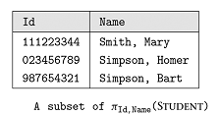

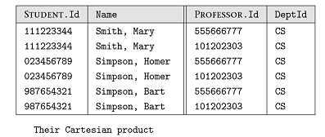
Example of Cartesian Product

Slide 101


Rename Operator
rename operator, denoted by the Greek letter rho
Suppose we want to find the names of all the customers who live on the same street and in the same city as Smith.
To find other customers with the same information, we need to reference the customer relation again

Slide 102

If we use this to rename one of the two customer relations we are using, the ambiguities will disappear.
We are renaming to cust2.

Slide 103
The Union Operation
The union operation is denoted U as in set theory. It returns the union set union of two compatible relations.
For a union operation r U s to be legal, we require that
r and s must have the same number of attributes.
The domains of the corresponding attributes must be the same.

Slide 104
The Union Operation
To find all customers of the SFU branch, we must find everyone who has a loan or an account or both at the branch. We need both borrow and deposit relations for this
As in all set operations, duplicates are eliminated

Slide 105
The Set Difference Operation
Set difference is denoted by the minus sign (-)
It finds tuples that are in one relation, but not in another.
Thus R – S results in a relation containing tuples that are in R but not is S.
To find customers of the SFU branch who have an account there but no loan, we write

Slide 106

The Set Intersection Operation
Set Intersection is denoted by
It returns a relation that contains tuples that are in both of its argument relations.
To find all customers having both a loan and an account at the SFU branch, we write

Slide 107
The Natural Join Operation
Often we want to simplify queries on a cartesian product
For example, to find all customers having a loan at the bank and the cities in which they live, we need borrow and customer relations
This type of operation is very common, so we have the natural join, denoted by a sign

Slide 108

Natural Join..
Natural join combines a Cartesian product and a selection into one operation.
It performs a selection forcing equality on those attributes that appear in both relation schemes.
Duplicates are removed as in all relation operations.

Slide 109
Basic Query Structure
The SQL data-manipulation language (DML) provides the ability to query information, and insert, delete and update tuples
A typical SQL query has the form: select A₁, A₂, ..., A_{n} from r₁, r₂, ..., r_{m} where P
A_{i} represents an attribute
R_{i} represents a relation
P is a predicate.
The result of an SQL query is a relation.
Notes:
2

Slide 110
The select Clause
The select clause list the attributes desired in the result of a query
corresponds to the projection operation of the relational algebra
Example: find the names of all instructors: select name from instructor
NOTE: SQL names are case insensitive (i.e., you may use upper- or lower-case letters.)
E.g. Name ≡ NAME ≡ name
Some people use upper case wherever we use bold font.
Notes:
3

Slide 111
The select Clause (Cont.)
SQL allows duplicates in relations as well as in query results.
To force the elimination of duplicates, insert the keyword distinct after select.
Find the names of all departments with instructor, and remove duplicates
select distinct dept_name from instructor
The keyword all specifies that duplicates not be removed.
select all dept_name from instructor
Notes:
4

Slide 112
The select Clause (Cont.)
An asterisk in the select clause denotes “all attributes”
select * from instructor
The select clause can contain arithmetic expressions involving the operation, +, –, ∗, and /, and operating on constants or attributes of tuples.
The query:
select ID, name, salary/12 from instructor
would return a relation that is the same as the instructor relation, except that the value of the attribute salary is divided by 12.
Notes:
5

Slide 113
The where Clause
The where clause specifies conditions that the result must satisfy
Corresponds to the selection predicate of the relational algebra.
To find all instructors in Comp. Sci. dept with salary > 80000 select name from instructor where dept_name = ‘Comp. Sci.' and salary > 80000
Comparison results can be combined using the logical connectives and, or, and not.
Comparisons can be applied to results of arithmetic expressions.
Notes:
6

Slide 114
The from Clause
The from clause lists the relations involved in the query
Corresponds to the Cartesian product operation of the relational algebra.
Find the Cartesian product instructor X teaches
select ∗ from instructor, teaches
generates every possible instructor – teaches pair, with all attributes from both relations
Cartesian product not very useful directly, but useful combined with where-clause condition (selection operation in relational algebra)
Notes:
8

Slide 115
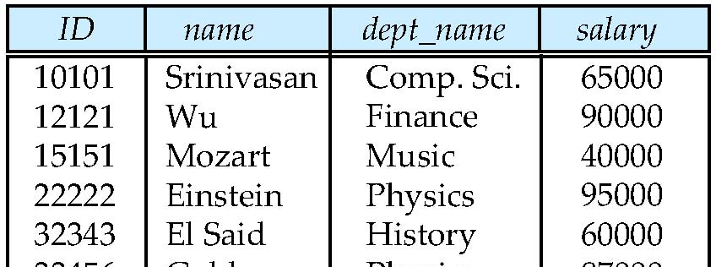
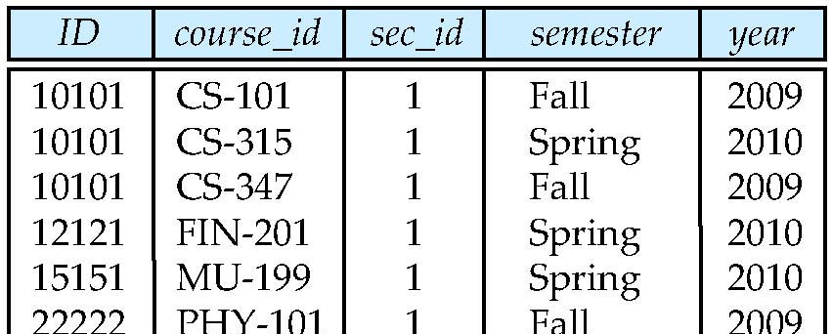
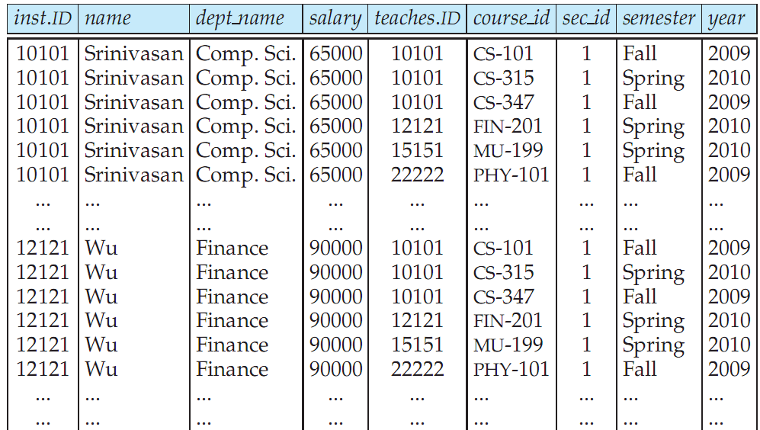
Cartesian Product: instructor X teaches
instructor
teaches

Slide 116
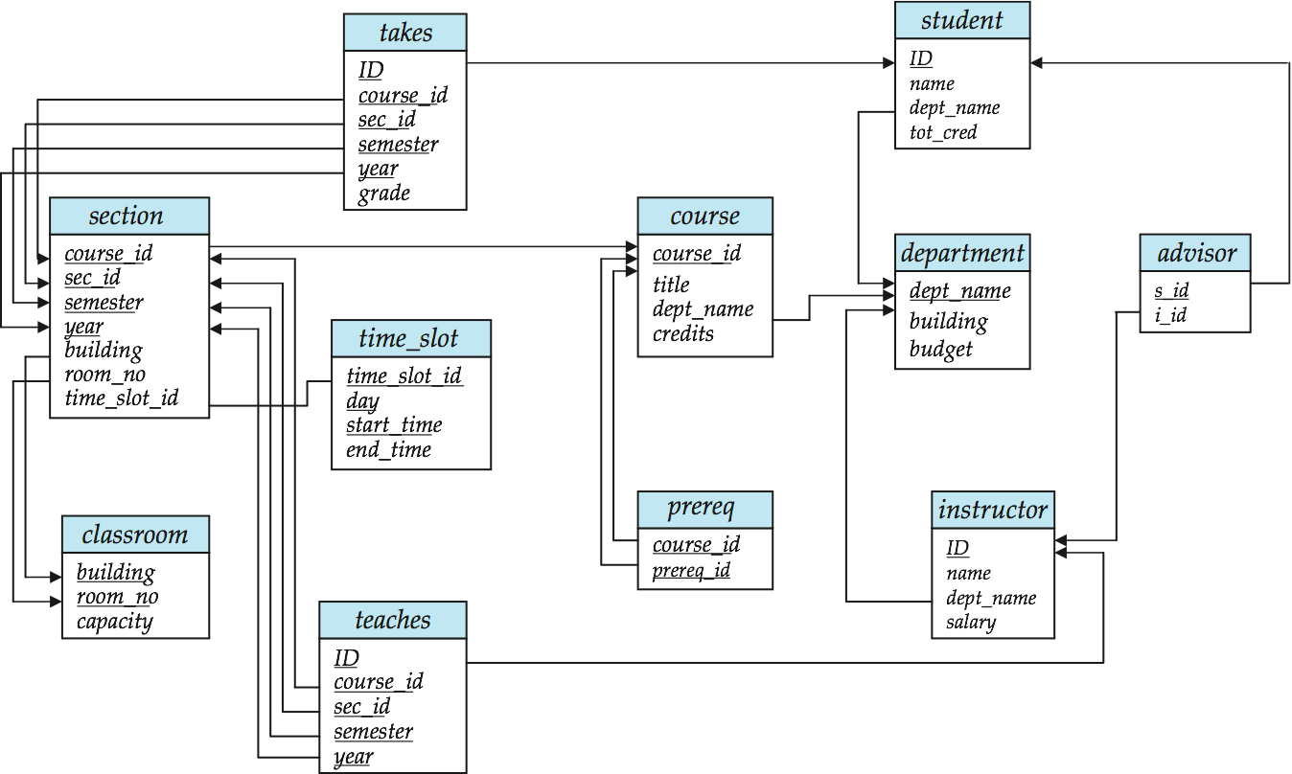
Joins
For all instructors who have taught some course, find their names and the course ID of the courses they taught.
select name, course_id from instructor, teaches where instructor.ID = teaches.ID
Find the course ID, semester, year and title of each course offered by the Comp. Sci. department
select section.course_id, semester, year, title from section, course where section.course_id = course.course_id and dept_name = ‘Comp. Sci.'

Slide 117
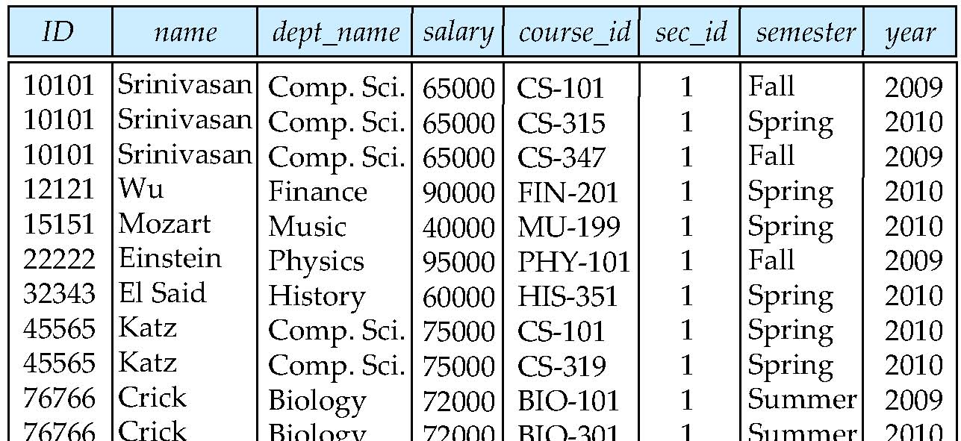
Natural Join
Natural join matches tuples with the same values for all common attributes, and retains only one copy of each common column
select * from instructor join teaches;

Slide 118
Natural Join Example
List the names of instructors along with the course ID of the courses that they taught.
select name, course_id from instructor, teaches where instructor.ID = teaches.ID;
select name, course_id from instructor natural join teaches;

Slide 119
Natural Join (Cont.)
Danger in natural join: beware of unrelated attributes with same name which get equated incorrectly
List the names of instructors along with the the titles of courses that they teach
Incorrect version (makes course.dept_name = instructor.dept_name)
select name, title from instructor join teaches join course;
Correct version
select name, title from instructor join teaches, course where teaches.course_id = course.course_id;

Slide 120
The Rename Operation
The SQL allows renaming relations and attributes using the as clause:
old-name as new-name
E.g.
select ID, name, salary/12 as monthly_salary from instructor
Find the names of all instructors who have a higher salary than some instructor in ‘Comp. Sci’.
select distinct T. name from instructor as T, instructor as S where T.salary > S.salary and S.dept_name = ‘Comp. Sci.’
Keyword as is optional and may be omitted instructor as T ≡ instructor T
Notes:
9

Slide 121
String Operations
SQL includes a string-matching operator for comparisons on character strings. The operator “like” uses patterns that are described using two special characters:
percent (%). The % character matches any substring.
underscore (_). The _ character matches any character.
Find the names of all instructors whose name includes the substring “dar”. select name from instructor where name like '%dar%'
Match the string “100 %”
like ‘100 \%' escape '\'

Slide 122
String Operations (Cont.)
Patters are case sensitive.
Pattern matching examples:
‘Intro%’ matches any string beginning with “Intro”.
‘%Comp%’ matches any string containing “Comp” as a substring.
‘_ _ _’ matches any string of exactly three characters.
‘_ _ _ %’ matches any string of at least three characters.
SQL supports a variety of string operations such as
concatenation (using “||”)
converting from upper to lower case (and vice versa)
finding string length, extracting substrings, etc.

Slide 123
Ordering the Display of Tuples
List in alphabetic order the names of all instructors select distinct name from instructor order by name
We may specify desc for descending order or asc for ascending order, for each attribute; ascending order is the default.
Example: order by name desc
Can sort on multiple attributes
Example: order by dept_name, name

Slide 124
Where Clause Predicates
SQL includes a between comparison operator
Example: Find the names of all instructors with salary between $90,000 and $100,000 (that is, ≥ $90,000 and ≤ $100,000)
select name from instructor where salary between 90000 and 100000
Tuple comparison
select name, course_id from instructor, teaches where (instructor.ID, dept_name) = (teaches.ID, ’Biology’);
Notes:
7

Slide 125
Duplicates
In relations with duplicates, SQL can define how many copies of tuples appear in the result.
Multiset versions of some of the relational algebra operators – given multiset relations r₁ and r₂:
1. σ_{θ} (r₁): If there are c₁ copies of tuple t₁ in r₁, and t₁ satisfies selections σ_{θ,}, then there are c₁ copies of t₁ in σ_{θ} (r₁).
2. Π_{A} (r ): For each copy of tuple t₁ in r₁, there is a copy of tuple Π_{A} (t₁) in Π_{A} (r₁) where Π_{A} (t₁) denotes the projection of the single tuple t₁.
3. r₁ x r₂ : If there are c₁ copies of tuple t₁ in r₁ and c₂ copies of tuple t₂ in r₂, there are c₁ x c₂ copies of the tuple t₁. t₂ in r₁ x r₂

Slide 126
Duplicates (Cont.)
Example: Suppose multiset relations r₁ (A, B) and r₂ (C) are as follows:
r₁ = {(1, a) (2,a)} r₂ = {(2), (3), (3)}
Then Π_{B}(r₁) would be {(a), (a)}, while Π_{B}(r₁) x r₂ would be
{(a,2), (a,2), (a,3), (a,3), (a,3), (a,3)}
SQL duplicate semantics:
select A₁,, A₂, ..., A_{n} from r₁, r₂, ..., r_{m} where P
is equivalent to the multiset version of the expression:

Slide 127
Set Operations
Find courses that ran in Fall 2009 or in Spring 2010
(select course_id from section where sem = ‘Fall’ and year = 2009) union (select course_id from section where sem = ‘Spring’ and year = 2010)
Find courses that ran in Fall 2009 and in Spring 2010
(select course_id from section where sem = ‘Fall’ and year = 2009) intersect (select course_id from section where sem = ‘Spring’ and year = 2010)
Find courses that ran in Fall 2009 but not in Spring 2010
(select course_id from section where sem = ‘Fall’ and year = 2009) except (select course_id from section where sem = ‘Spring’ and year = 2010)

Slide 128
Set Operations
Set operations union, intersect, and except
Each of the above operations automatically eliminates duplicates
To retain all duplicates use the corresponding multiset versions union all, intersect all and except all. Suppose a tuple occurs m times in r and n times in s, then, it occurs:
m + n times in r union all s
min(m,n) times in r intersect all s
max(0, m – n) times in r except all s

Slide 129
Null Values
It is possible for tuples to have a null value, denoted by null, for some of their attributes
null signifies an unknown value or that a value does not exist.
The result of any arithmetic expression involving null is null
Example: 5 + null returns null
The predicate is null can be used to check for null values.
Example: Find all instructors whose salary is null.
select name from instructor where salary is null

Slide 130
Functional Dependency

Slide 131
Overview
Domain; Ref. Integrity constraints
Assertions and Triggers
Security
Functional dependencies
why
definition
Armstrong’s “axioms”
closure and cover

Slide 132
Functional dependencies
takes1 (ssn, c-id, grade, name, address)

Slide 133
Functional Dependencies
Redundancy
space
inconsistencies
insertion/deletion anomalies
What caused the problem?

Slide 134
Functional dependencies
Definition:
‘a’ functionally determines ‘b’

Slide 135
Functional dependencies
formally:
if two tuples agree on the ‘X’ attribute,
they *must* agree on the ‘Y’ attribute, too
(e.g., if ssn is the same, so should address)
… a functional dependency is a generalization of the notion of a key

Slide 136
Functional dependencies
K is a superkey for relation R iff K -> R
K is a candidate key for relation R iff:
K -> R
for no a ⊂ K, a -> R

Slide 137
Functional dependencies
Closure of a set of FD: all implied FDs – e.g.:
ssn -> name, address
ssn, c-id -> grade
imply
ssn, c-id -> grade, name, address
ssn, c-id -> ssn

Slide 138
FDs - Armstrong’s axioms
Closure of a set of FD: all implied FDs – e.g.:
ssn -> name, address
ssn, c-id -> grade
how to find all the implied ones, systematically?

Slide 139
FDs - Armstrong’s axioms
“Armstrong’s axioms” guarantee soundness and completeness:
Reflexivity:
e.g., ssn, name -> ssn
Augmentation
e.g., ssn->name then ssn,grade-> ssn,grade

Slide 140
FDs - Armstrong’s axioms
Transitivity
ssn->address
address-> county-tax-rate
THEN:
ssn-> county-tax-rate

Slide 141
FDs - Armstrong’s axioms
Reflexivity:
Augmentation:
Transitivity:
‘sound’ and ‘complete’

Slide 142
Trivial FDs
The FD X→Y is trivial if set {Y} is a subset of set {X}
Examples: If A and B are attributes of R,
{A}→{A}
{A,B} →{A}
{A,B} →{B}
{A,B} →{A,B}
are all trivial FDs.

Slide 143
Full functional Dependency
A full functional dependency occurs when you already meet the requirements for a functional dependency and the set of attributes on the left side of the functional dependency statement cannot be reduced any farther.
For example, “{SSN, age} -> name” is a functional dependency, but it is not a full functional dependency because you can remove age from the left side of the statement without impacting the dependency relationship

Slide 144
Closure of a set of attributes
Closure of a set of attributes X with respect to is the set X⁺ of all attributes that are functionally determined by X using ⁺
Imagine the following list of FD's. We are going to calculate a closure for A from this relationship.
A → B B → C AB → D
The closure would be as follows:
a) A → A ( by Armstrong's reflexivity ) b) A → AB ( by 1. and (a )) c) A → ABD ( by (b), 3, and Armstrong's transitivity ) d) A → ABCD ( by (c), and 2 )
The closure is therefore A → ABCD. By calculating the closure of A, we have validated that A is also a good candidate key as its closure is every single data value in the relationship.

Slide 145
FDs – finding the closure F+
F⁺ = F
repeat for each functional dependency f in F⁺
apply reflexivity and augmentation rules on f add the resulting functional dependencies to F⁺ for each pair of functional dependencies f₁and f₂ in F⁺ if f₁ and f₂ can be combined using transitivity then add the resulting functional dependency to F⁺
until F⁺ does not change any further
We can further simplify manual computation of F⁺ by using the following additional rules →

Slide 146
FDs - Armstrong’s axioms
Additional rules:
Union
Decomposition
Pseudo-transitivity

Slide 147
FDs - Closure A+
Algorithm to compute α⁺, the closure of α under F
result := α; while (changes to result) do for each β → γ in F do begin if β ⊆ result then result := result ∪ γ end

Slide 148
FDs - Closure A+ (example)
R = (A, B, C, G, H, I)
F = {A → B, A → C, CG → H, CG → I, B → H}
(AG)⁺
1. result = AG
2. result = ABCG (A → C and A → B)
3. result = ABCGH (CG → H and CG ⊆ AGBC)
4. result = ABCGHI (CG → I and CG ⊆ AGBCH)
Is AG a candidate key?
Is AG a super key?
Does AG → R?
Is any subset of AG a superkey?
Does A⁺ → R?
Does G⁺ → R?

Slide 149
Normalization

Slide 150
Definitions
For any relation extension or state
Superkey: a set of attributes uniquely (but not necessarily minimally!) identifying a tuple of a relation.
Key: A set of attributes that uniquely and minimally identifies a tuple of a relation.
Candidate key: If there is more than one key in a relation, the keys are called candidate keys.
Primary key: One candidate key is chosen to be the primary key.
Prime attribute: An attribute A that is part of a candidate key X (vs. nonprime attribute)
Notes:
Show it using the EMP relation:
Given the previous relation
EMP(ID, NAME, BIRTHDATE, TELEPHONE, CITY, ZIPCODE) or rather R={ID, NAME, BIRTHDATE, TELEPHONE, CITY, ZIPCODE, ...}
With functional dependencies
ID → NAME, BIRTHDATE, TELEPHONE, CITY, ZIPCODE
NAME, BIRTHDATE → ID, TELEPHONE, CITY, ZIPCODE in a small world with non-generic names
ZIPCODE → CITY
TELEPHONE → CITY (if it is not a mobile phone)
There are two keys: EMPID and NAME, BIRTHDATE. As there are more than one key they are called candidate key. EMPID is chosen as primary key. Prime attributes are EMPID, NAME, BIRTHDATE
Another example:
Car(RegNo, Brand, Colour)
Key: RegNo, no candidate key, primary key RegNo with only one prime attribute
Now come the normal forms.

Slide 151
Normal Forms
1NF, 2NF, 3NF, BCNF (4NF, 5NF)
Minimize redundancy
Minimize update anomalies
Normal form ↑ = redundancy and update anomalies ↓ and relations become smaller.
Join operation to recover original relations.

Slide 152
1NF
1NF: The relation should have no non-atomic values.
What about multi-valued attributes ?
R_{non1NF}
ID | Name | LivesIn
100 | Pettersson | {Stockholm, Linköping}
101 | Andersson | {Linköping}
102 | Svensson | {Ystad, Hjo, Berlin}
R2_{1NF}
ID | LivesIn
100 | Stockholm
100 | Linköping
101 | Linköping
102 | Ystad
102 | Hjo
102 | Berlin
R1_{1NF}
Normalization
ID | Name
100 | Pettersson
101 | Andersson
102 | Svensson
Notes:
Not really a normal form but a design decision.
Most relational databases do not support non-atomic values.
However, non-1NF-databases are coming.
How to bring a non-1NF in 1NF?
Same way we solved multi-valued attributes in ER-diagrams:
Create a new relation, use primary key of first relation as foreign key and prime attribute in the new relation, use the multi-valued attribute also as prime attribute.
Person(Name)
LivesIn(Name, City)

Slide 153
2NF
2NF: no nonprime attribute should be functionally dependent on a part of a candidate key.
R_{non2NF}
EmpID | Dept | Work% | EmpName
100 | Dev | 50 | Baker
100 | Support | 50 | Baker
200 | Dev | 80 | Miller
R2_{2NF}
R1_{2NF}
EmpID | Dept | Work%
100 | Dev | 50
100 | Support | 50
200 | Dev | 80
Normalization
EmpID | EmpName
100 | Baker
200 | Miller
Notes:
1NF is not a pre-requisite. 2NF is important even for non-1NF-databases.
Another formulation: every non-prime attribute A in R is ffd on any candidate key of R.
Functional dependencies:
EmpID → EmpName
EmpID, dept → work_%
It is not in 2NF because EmpName is ffd only on EmpID , not on {EmpID , Dept}.
Real world problem: If Miller starts working at Support with 20% the new tuple must contain Miller with her correct name (possible insertion anomaly). Also if Miller changes her name, all Miller-tuples need to be updated (modification anomaly).
How to bring a non-2NF in 2NF?
Emp(EmpID, EmpName) and WorkPercent(EmpID , dept, work_%)
Split in new relations for each identified determinant.
Relations with only one prime attribute in the candidate keys are always in 2NF.

Slide 154
2NF
No 2NF: A part of a candidate key can have repeated values in the relation and, thus, so can have the nonprime attribute, i.e. redundancy + insertion and modification anomalies.
An FD X→Y is a full functional dependency (FFD) if removal of any attribute A_{i} from X means that the dependency does not hold any more.
2NF: Every nonprime attribute is fully functionally dependent on every candidate key.
Notes:
Given the previous relation EMP(ID, NAME, BIRTHDATE, TELEPHONE, CITY, ZIPCODE) or rather R={ID, NAME, BIRTHDATE, TELEPHONE, CITY, ZIPCODE, ...}
With functional dependencies ID → NAME, BIRTHDATE, TELEPHONE, CITY, ZIPCODE NAME, BIRTHDATE → ID, TELEPHONE, CITY, ZIPCODE in a small world with non-generic names ZIPCODE → CITY TELEPHONE → CITY (if it is not a mobile phone)
Superkey ID, CITY → NAME, BIRTHDATE, TELEPHONE, ZIPCODE ID, CITY is a superkey of EMP but they are not really interesting. We are interested in minimal or full functional dependencies, thus: ID → ZIPCODE Super in superkey means extra-large, not extra-good.
Inference rules for functional (but not full) dependencies:
If X ⊇ Y, then X→Y or X → X (reflexive rule)
X→Y |= XZ → YZ (augmentation rule)
X → Y, Y → Z |= X → Z (transitive rule)
X → YZ |= X → Y (decomposition rule)
X → Y, X → Z |= X → Y, Z (union or additive rule)
X → Y, WY → Z |= WX → Z (pseudotransitive rule)

Slide 155
3NF
3NF: 2NF + no nonprime attribute should be functionally dependent on a set of attributes that is not a candidate key
R_{non3NF}
ID | Name | Zip | City
100 | Andersson | 58214 | Linköping
101 | Björk | 10223 | Stockholm
102 | Carlsson | 58214 | Linköping
R1_{3NF}
R2_{3NF}
Normalization
ID | Name | Zip
100 | Andersson | 58214
101 | Björk | 10223
102 | Carlsson | 58214
Zip | City
58214 | Linköping
10223 | Stockholm
Notes:
Data tuples:
100, Baker, 582 14, Linköping
101, Smith, 102 23, Stockholm
102, Miller, 583 30, Linköping
Functional dependencies:
EmpID → name, zip, city
EmpID → zip
EmpID → city
zip → city
this relation is in 2NF because all non-key attributes are ffd on the primary key, but it is not in 3NF because one non-key attribute determines another non-key attribute.
Problem: When inserting new tuples, the relation allows the insertion of ..., 582 14, Norrköping, ... Even though 582 14, Linköping already exists.
Can be remedied by again splitting the relation so that zip→city forms a separate relation and by not having city as attribute in EMP.

Slide 156
3NF
No 3NF (but 2NF): A set of attributes that is not a candidate key can have repeated values in the relation and, thus, so can have the nonprime attribute, i.e. redundancy + insertion and modification anomalies.
An FD X→Y is a transitive dependency if there is a set of attributes Z that is not a candidate key and such that both X→Z and Z→Y hold.
3NF: 2NF + no nonprime attribute is transitively dependent on any candidate key.

Slide 157
Boyce-Codd Normal Form
BCNF: Every determinant is a candidate key
BCNF = decompose if X → A is such that X is not a candidate key and A is a prime attribute.
Example: Given R(A,B,C,D) and AB→CD, C→B. Then R is in 3NF but not in BCNF
C is a determinant but not a candidate key.
Decompose into R1(A,C,D) with AC → D and R2(C,B) with C → B.
Notes:
Was for a few years thought to be the ultimate normal form until a colleague of Codd came up with even higher forms.
Normally, this is the highest form that should be achieved.
Given R={A, B, C, D} and the functional dependencies
A, B → C, D
D → B
R is not in BCNF because D is not a superkey (D cannot be made into a candidate key by dropping 0 or more attributes from it).
But allowed:
A → B, C, D
B → A, C, D because every determinant is a candidate key (=a minimal superkey).
Yes, A depends on B but both are key attributes!
Typical real-word example: Database key ID vs. Personnummer

Slide 158
Properties of decomposition
Keep all attributes from the universal relation R.
Preserve the identified functional dependencies.
Lossless join
It must be possible to join the smaller tables to arrive at composite information without spurious tuples.

Slide 159
Normalization: Example
Given universal relation
R(PID, PersonName, Country, Continent, ContinentArea, NumberVisitsCountry)
Functional dependencies?
Keys?
Notes:
Functional dependencies can only be determined by you.
The key follows from the functional dependencies.
Universal relation – all attributes in the database. Use FD to decompose universal relation into a set of relation schemas.

Slide 160
Normalization: Example
PID → PersonName
PID, Country → NumberVisitsCountry
Country → Continent
Continent → ContinentArea
Based on FDs, what are keys for R?
Use inference rules

Slide 161
Normalization: Example
Country → Continent, Continent → ContinentArea,
then
Country → Continent, ContinentArea (transitive + aditive rules)
PID, Country → Continent, ContinentArea (augmentation + decomposition rules),
PID, Country → PersonName (augmentation + decomposition rules),
PID, Country → NumberVisitsCountry,
then
PID, Country → Continent, ContinentArea, PersonName, NumberVisitsCountry (additive rule)
PID, Country is the key for R.

Slide 162
Is R (PID,Country,Continent,ContinentArea,PersonName,NumberVisitsCountry) in 2NF?
Normalization: Example
No, PersonName depends on a part of the candidate key (PID), then
R1(PID, PersonName)
R2(PID, Country, Continent, ContinentArea, NumberVisitsCountry)
Is R2 in 2NF?
No, Continent and ContinentArea depend on a part of the candidate key (Country), then
R1(PID, PersonName)
R21(Country, Continent, ContinentArea)
R22(PID, Country, NumberVisitsCountry)
→ R1, R21, R22 are in 2NF
2NF: no nonprime attribute should be functionally dependent on a part of a candidate key.

Slide 163
Are R1, R21, R22 in 3NF?
3NF: 2NF + no nonprime attribute should be functionally dependent on a set of attributes that is not a candidate key
R22(PID, Country, NumberVisitsCountry),
R1(PID, PersonName):
Yes, a single nonprime attribute, no transitive dependencies.
R21(Country, Continent, ContinentArea):
No, Continent defines ContinentArea, then
R211(Country, Continent)
R212(Continent, ContinentArea)
→ R1, R22, R211, R212 are in 3NF

Slide 164
Are R1, R22, R211, R212 in BCNF?
BCNF: Every determinant is a candidate key
R22(PID, Country, NumberVisitsCountry),
R1(PID, PersonName):
R211(Country, Continent)
R212(Continent, ContinentArea)
Yes
Can the universal relation R be reproduced from R1, R22, R211 and R212 without spurious tuples?
Notes:
select r22.pid, r22.land, r22.antalbesök, r1.personName, r211.Continent, r212.ContinentArea
from r22, r1, r211, r212
where r22.pid=r1.pid
and r22.land=r211.land
and r211.Continent=r212.Continent;

Slide 165
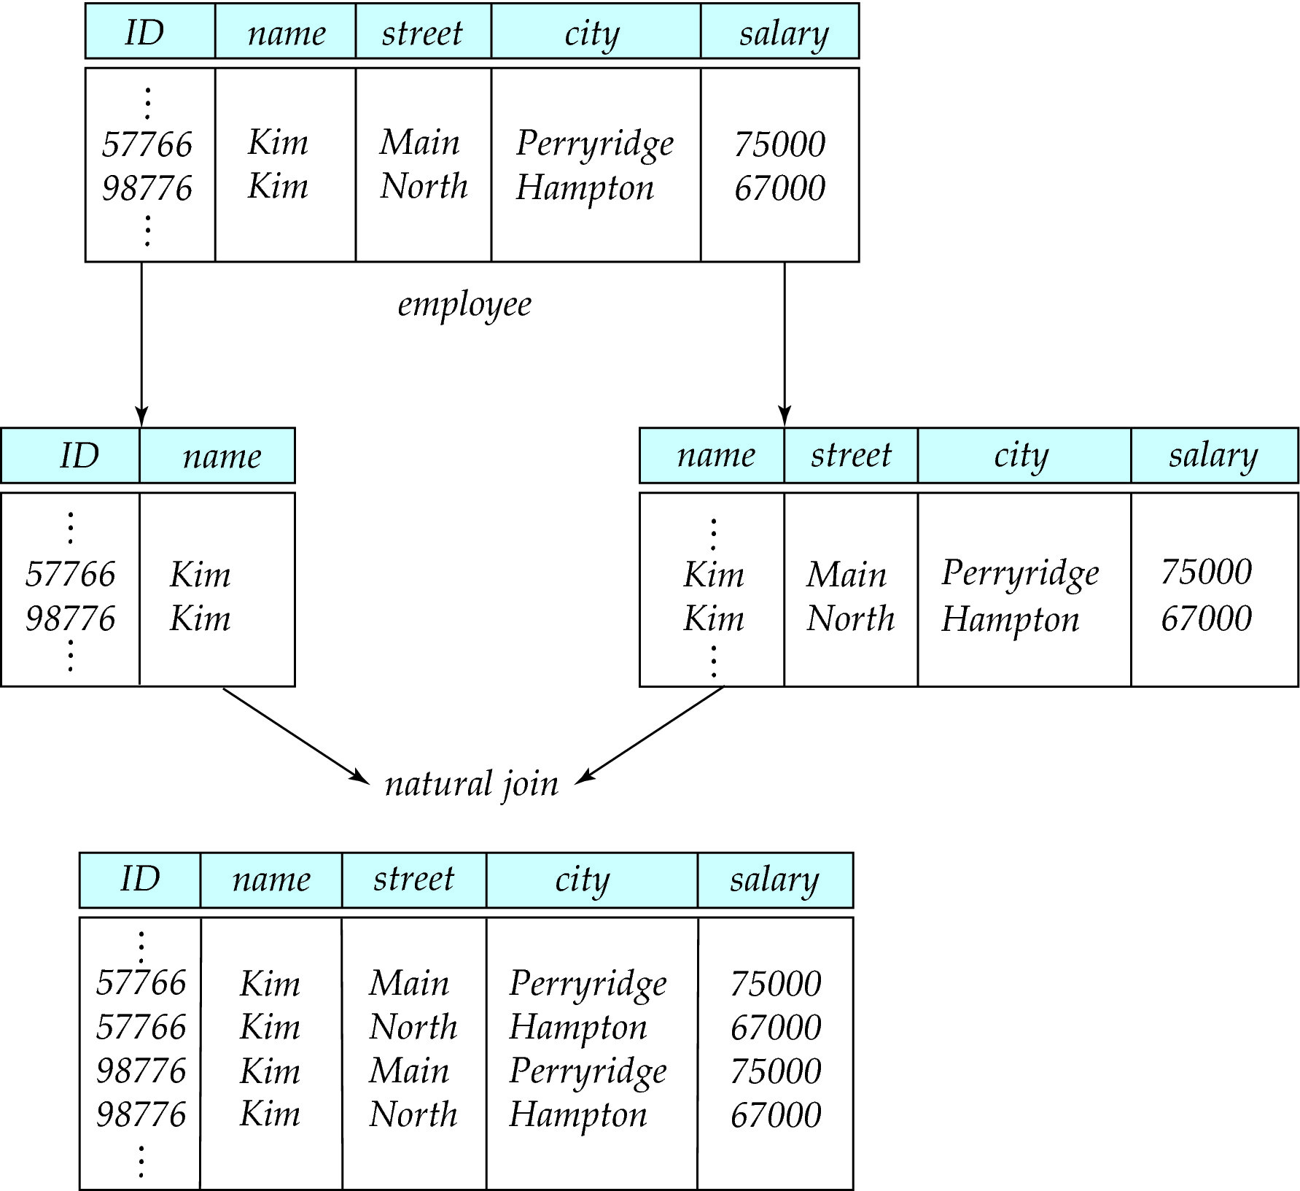
A Lossy Decomposition

Slide 166
Lossless join decomposition
Decomposition of R = (A, B, C) R₁ = (A, B) R₂ = (B, C)
A
B
C
A
B
B
C
α
β
1
2
A
B
α
β
1
2
1
2
A
B
r
∏_{A,B}(r)
∏_{B,C}(r)
∏_{A} (r) ∏_{B} (r)
A
B
C
α
β
1
2
A
B

Slide 167
Sufficient Condition for Lossless Join
Lossless Join means:
Let { R₁ , R₂ } be a decomposition of R (meaning that R₁ ∪ R₂ = R);
Prove that for all legal instances r:
r ⊆ Π_{R1}(r)  Π_{R2}(r)
Prove that this decomposition is lossless if R₁ ∩ R₂ → R₁ or R₁ ∩ R₂ → R₂
Give an example of a lossless join decomposition (instance) when neither
R₁ ∩ R₂ → R₁ nor R₁ ∩ R₂ → R₂ hold?
Notes:
Name r1= Π_{R1}(r) ; r2= Π_{R2}(r); rjoin = r1 ¦x¦ r2 (r1 join r2)
r ⊆ Π_{R1}(r) Π_{R2}(r)
Demo explanation: if t ∈ r than we have t[R1] ∈ r1 and t[R2] ∈ r2, and t = t[r1] ∪ t[r2]
(we use t[R1] here as a function)
for each t ∈ r it holds that the two projections of t appear in r1 rsp. r2, and because
t[R1] and t[R2] have the same value on r1 ∩ r2, they will also be matched in the join, q.e.d.
Demo: in other words: for ∀t ∈ r ,
t[R1] ∈ r1, so ∃t1 ∈ r1 with t[R1]=t1[R1]
t[R2] ∈ r2, so ∃t2 ∈ r2 with t[R2]=t2[R2]
and, because of the definition of the join, if t1[R1] ∈ r1 and t2[R2] ∈ r2 and rjoin = r1 ¦x¦ r2 , then
∃t3 ∈ rjoin with t3[R1]=t1[R1] and t3[R2]=t2[R2]
But this means that t3[R1]=t[R1] and t3[R2]=t[R2] so t3=t;
So we have proven that for ∀t ∈ r , ∃t3 ∈ rjoin with t3=t; so r ⊆ Π_{R1}(r) Π_{R2}(r); q.e.d.
Π_{R1}(r) Π_{R2}(r) ⊆r
Demo explanation: To prove the lossless-ness, we have to show that Π_{R1}(r) Π_{R2}(r) ⊆r.
suppose that R₁ ∩ R₂ → R₁ and take t1 and t2 from r so that t1[R1 ∩ R2] = t2[R1 ∩ R2]
(so t1 and t2 are matched in the join). The new tuple t1[R1] ∪ t2[R2]
is the same as t2[R1] ∪ t2[R2] and therefore the tuple is in r.
Demo: for ∀t ∈ rjoin ∃t1, t2 ∈ r so that:
t[R1]=t1[R1]
t[R1]=t2[R2]
But because R₁ ∩ R₂ → R₁ and because t1[R₁ ∩ R₂] = t2[R₁ ∩ R₂] => t1[R1] = t2[R1] => t=t2;
So we have shown that for ∀t ∈ rjoin ∃ t2 ∈ r with t=t2; so Π_{R1}(r) Π_{R2}(r) ⊆r; q.e.d
Example of lossless join where R₁ ∩ R₂ → R₁ and R₁ ∩ R₂ → R₂ don’t hold:
The trick is to create a relation table that contains two disjunctive parts,
so that in one part R₁ ∩ R₂→ R₁ does not hold, and in the other part, R₁ ∩R₂→ R₂ does not hold.
Take for instance { A, B, C } and B → A and B → C both are not valid, however
{A,B} and {B,C} is a lossless join decomposition
A B C
---------------------
0 0 0
0 0 1
1 1 2
2 1 2

Slide 168
Canonical Cover
Sets of functional dependencies may have redundant dependencies that can be inferred from the others
For example: A → C is redundant in: {A → B, B → C, A→ C}
Parts of a functional dependency may be redundant
E.g.: on RHS: {A → B, B → C, A → CD} can be simplified to {A → B, B → C, A → D}
E.g.: on LHS: {A → B, B → C, AC → D} can be simplified to {A → B, B → C, A → D}

Slide 169
Dependency Preservation
Let F_{i} be the set of dependencies F ⁺ that include only attributes in R_{i}.
A decomposition is dependency preserving, if
(F₁ ∪ F₂ ∪ … ∪ F_{n} )⁺ = F ⁺
If it is not, then checking updates for violation of functional dependencies may require computing joins, which is expensive.
In simple term, any functional dependency can be tested in one relation.(join not required)

Slide 170
Comparison of BCNF and 3NF
It is always possible to decompose a relation into a set of relations that are in 3NF such that:
the decomposition is lossless
the dependencies are preserved
It is always possible to decompose a relation into a set of relations that are in BCNF such that:
the decomposition is lossless
it may not be possible to preserve dependencies.

Slide 171
Summary and open issues
Good design: informal and formal properties of relations
Functional dependencies, and thus normal forms, are about attribute semantics (= real-world knowledge), normalization can only be automated if FDs are given.
Are high normal forms good design when it comes to performance?
No, denormalization may be required.
Notes:
ER: Ternary relationship translates to SELL and contains redundancies but is needed if e.g. Miller only sells GM cars but Ford cars and trucks.
Three N:M-relationships allow for cases where agents represent companies without selling what the company makes or sell products without representing a company that makes the product.
Better to have three tables that represent an N:M-relationship between a, p and c.
Represents(a, c)
Makes(c, p)
Sells(a, p)
Easier to update if GM does not make trucks any more, if Ford starts making trucks, if Smith starts selling trucks etc.
Easier to insert new agents:
If Baker sells cars and trucks for Mercedes, GM and Ford this takes
2+3 new entries (2 in Sells, 3 in Represents) instead of
2*3 new entries in SELL.
Practical relevance: Due to the need of intrinsic semantic knowledge these normal forms are rarely deployed.

Slide 172
Chapter 15: Transactions
Transaction Concept
Transaction State
Implementation of Atomicity and Durability
Concurrent Executions
Serializability
Recoverability
Implementation of Isolation
Transaction Definition in SQL
Testing for Serializability.

Slide 173
Transaction Concept
A transaction is a unit of program execution that accesses and possibly updates various data items.
A transaction must see a consistent database.
During transaction execution the database may be inconsistent.
When the transaction is committed, the database must be consistent.
Two main issues to deal with:
Failures of various kinds, such as hardware failures and system crashes
Concurrent execution of multiple transactions

Slide 174
ACID Properties
To preserve integrity of data, the database system must ensure:
Atomicity. Either all operations of the transaction are properly reflected in the database or none are.
Consistency. Execution of a transaction in isolation preserves the consistency of the database.
Isolation. Although multiple transactions may execute concurrently, each transaction must be unaware of other concurrently executing transactions. Intermediate transaction results must be hidden from other concurrently executed transactions.
That is, for every pair of transactions T_{i} and T_{j}, it appears to T_{i} that either T_{j}, finished execution before T_{i} started, or T_{j} started execution after T_{i} finished.
Durability. After a transaction completes successfully, the changes it has made to the database persist, even if there are system failures.

Slide 175
Example of Fund Transfer
Transaction to transfer $50 from account A to account B:
1. read(A)
2. A := A – 50
3. write(A)
4. read(B)
5. B := B + 50
6. write(B)
Consistency requirement – the sum of A and B is unchanged by the execution of the transaction.
Atomicity requirement — if the transaction fails after step 3 and before step 6, the system should ensure that its updates are not reflected in the database, else an inconsistency will result.

Slide 176
Example of Fund Transfer (Cont.)
Durability requirement — once the user has been notified that the transaction has completed (i.e., the transfer of the $50 has taken place), the updates to the database by the transaction must persist despite failures.
Isolation requirement — if between steps 3 and 6, another transaction is allowed to access the partially updated database, it will see an inconsistent database (the sum A + B will be less than it should be). Can be ensured trivially by running transactions serially, that is one after the other. However, executing multiple transactions concurrently has significant benefits, as we will see.

Slide 177
Transaction State
Active, the initial state; the transaction stays in this state while it is executing
Partially committed, after the final statement has been executed.
Failed, after the discovery that normal execution can no longer proceed.
Aborted, after the transaction has been rolled back and the database restored to its state prior to the start of the transaction. Two options after it has been aborted:
restart the transaction – only if no internal logical error
kill the transaction
Committed, after successful completion.

Slide 178
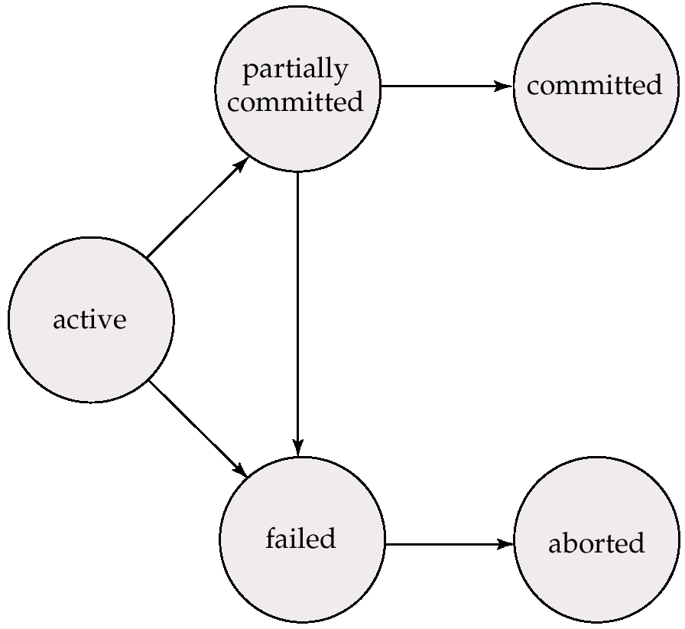
Transaction State (Cont.)

Slide 179
Implementation of Atomicity and Durability
The recovery-management component of a database system implements the support for atomicity and durability.
The shadow-database scheme:
assume that only one transaction is active at a time.
a pointer called db_pointer always points to the current consistent copy of the database.
all updates are made on a shadow copy of the database, and db_pointer is made to point to the updated shadow copy only after the transaction reaches partial commit and all updated pages have been flushed to disk.
in case transaction fails, old consistent copy pointed to by db_pointer can be used, and the shadow copy can be deleted.

Slide 180
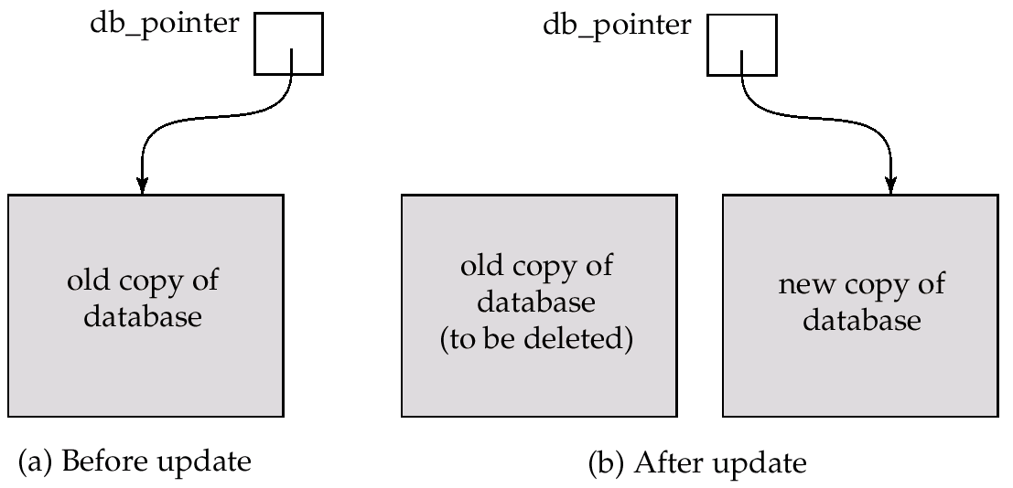
Implementation of Atomicity and Durability (Cont.)
The shadow-database scheme:
Assumes disks to not fail
extremely inefficient for large databases: executing a single transaction requires copying the entire database..

Slide 181
Concurrent Executions
Multiple transactions are allowed to run concurrently in the system. Advantages are:
increased processor and disk utilization, leading to better transaction throughput: one transaction can be using the CPU while another is reading from or writing to the disk
reduced average response time for transactions: short transactions need not wait behind long ones.
Concurrency control schemes – mechanisms to achieve isolation, i.e., to control the interaction among the concurrent transactions in order to prevent them from destroying the consistency of the databas

Slide 182
Schedules
Schedules – sequences that indicate the chronological order in which instructions of concurrent transactions are executed
a schedule for a set of transactions must consist of all instructions of those transactions
must preserve the order in which the instructions appear in each individual transaction.

Slide 183
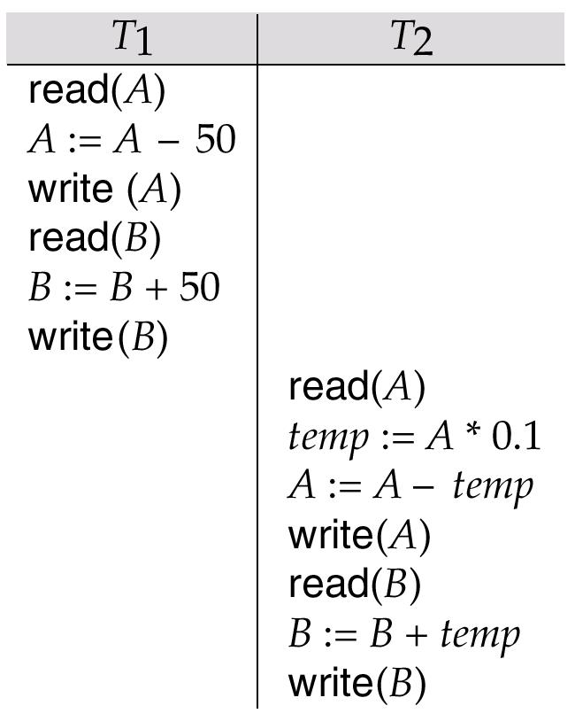
Example Schedules
Let T₁ transfer $50 from A to B, and T₂ transfer 10% of the balance from A to B. The following is a serial schedule (Schedule 1 in the text), in which T₁ is followed by T₂.

Slide 184
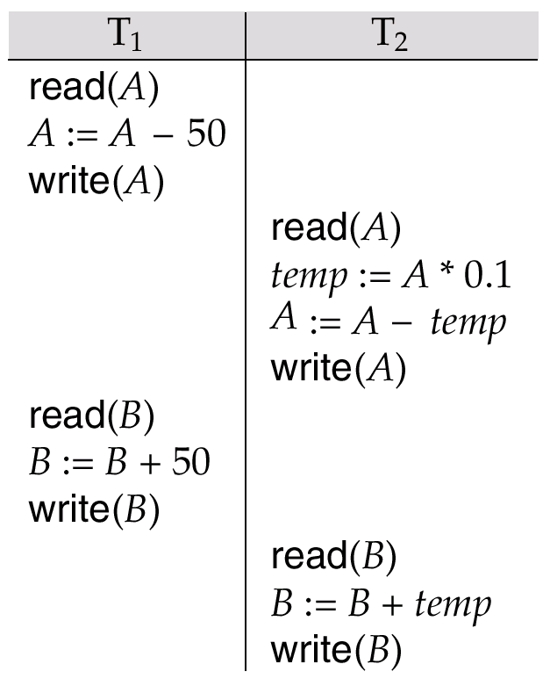
Example Schedule (Cont.)
Let T₁ and T₂ be the transactions defined previously. The following schedule (Schedule 3 in the text) is not a serial schedule, but it is equivalent to Schedule 1.
In both Schedule 1 and 3, the sum A + B is preserved.

Slide 185

Example Schedules (Cont.)
The following concurrent schedule (Schedule 4 in the text) does not preserve the value of the the sum A + B.

Slide 186
Serializability
Basic Assumption – Each transaction preserves database consistency.
Thus serial execution of a set of transactions preserves database consistency.
A (possibly concurrent) schedule is serializable if it is equivalent to a serial schedule. Different forms of schedule equivalence give rise to the notions of:
1. conflict serializability
2. view serializability
We ignore operations other than read and write instructions, and we assume that transactions may perform arbitrary computations on data in local buffers in between reads and writes. Our simplified schedules consist of only read and write instructions.

Slide 187
Conflict Serializability
Instructions l_{i} and l_{j} of transactions T_{i} and T_{j} respectively, conflict if and only if there exists some item Q accessed by both l_{i} and l_{j}, and at least one of these instructions wrote Q.
1. l_{i} = read(Q), l_{j} = read(Q). l_{i} and l_{j} don’t conflict. 2. l_{i} = read(Q), l_{j} = write(Q). They conflict. 3. l_{i} = write(Q), l_{j} = read(Q). They conflict 4. l_{i} = write(Q), l_{j} = write(Q). They conflict
Intuitively, a conflict between l_{i} and l_{j} forces a (logical) temporal order between them. If l_{i} and l_{j} are consecutive in a schedule and they do not conflict, their results would remain the same even if they had been interchanged in the schedule.

Slide 188
Conflict Serializability (Cont.)
If a schedule S can be transformed into a schedule S´ by a series of swaps of non-conflicting instructions, we say that S and S´ are conflict equivalent.
We say that a schedule S is conflict serializable if it is conflict equivalent to a serial schedule
Example of a schedule that is not conflict serializable:
T₃ T₄ read(Q) write(Q) write(Q) We are unable to swap instructions in the above schedule to obtain either the serial schedule < T₃, T₄ >, or the serial schedule < T₄, T₃ >.

Slide 189

Conflict Serializability (Cont.)
Schedule 3 below can be transformed into Schedule 1, a serial schedule where T₂ follows T₁, by series of swaps of non-conflicting instructions. Therefore Schedule 3 is conflict serializable.

Slide 190
View Serializability
Let S and S´ be two schedules with the same set of transactions. S and S´ are view equivalent if the following three conditions are met:
1. For each data item Q, if transaction T_{i} reads the initial value of Q in schedule S, then transaction T_{i} must, in schedule S´, also read the initial value of Q.
2. For each data item Q if transaction T_{i} executes read(Q) in schedule S, and that value was produced by transaction T_{j} (if any), then transaction T_{i} must in schedule S´ also read the value of Q that was produced by transaction T_{j} .
3. For each data item Q, the transaction (if any) that performs the final write(Q) operation in schedule S must perform the final write(Q) operation in schedule S´.
As can be seen, view equivalence is also based purely on reads
and writes alone.

Slide 191

View Serializability (Cont.)
A schedule S is view serializable it is view equivalent to a serial schedule.
Every conflict serializable schedule is also view serializable.
Schedule 9 (from text) — a schedule which is view-serializable but not conflict serializable.
Every view serializable schedule that is not conflict serializable has blind writes.

Slide 192

Other Notions of Serializability
Schedule 8 (from text) given below produces same outcome as the serial schedule < T₁, T₅ >, yet is not conflict equivalent or view equivalent to it.
Determining such equivalence requires analysis of operations other than read and write.

Slide 193

Recoverability
Need to address the effect of transaction failures on concurrently running transactions.
Recoverable schedule — if a transaction T_{j} reads a data items previously written by a transaction T_{i} , the commit operation of T_{i} appears before the commit operation of T_{j}.
The following schedule (Schedule 11) is not recoverable if T₉ commits immediately after the read
If T₈ should abort, T₉ would have read (and possibly shown to the user) an inconsistent database state. Hence database must ensure that schedules are recoverable.

Slide 194

Recoverability (Cont.)
Cascading rollback – a single transaction failure leads to a series of transaction rollbacks. Consider the following schedule where none of the transactions has yet committed (so the schedule is recoverable) If T₁₀ fails, T₁₁ and T₁₂ must also be rolled back.
Can lead to the undoing of a significant amount of work

Slide 195
Recoverability (Cont.)
Cascadeless schedules — cascading rollbacks cannot occur; for each pair of transactions T_{i} and T_{j} such that T_{j} reads a data item previously written by T_{i}, the commit operation of T_{i} appears before the read operation of T_{j}.
Every cascadeless schedule is also recoverable
It is desirable to restrict the schedules to those that are cascadeless

Slide 196
Implementation of Isolation
Schedules must be conflict or view serializable, and recoverable, for the sake of database consistency, and preferably cascadeless.
A policy in which only one transaction can execute at a time generates serial schedules, but provides a poor degree of concurrency..
Concurrency-control schemes tradeoff between the amount of concurrency they allow and the amount of overhead that they incur.
Some schemes allow only conflict-serializable schedules to be generated, while others allow view-serializable schedules that are not conflict-serializable.

Slide 197
Transaction Definition in SQL
Data manipulation language must include a construct for specifying the set of actions that comprise a transaction.
In SQL, a transaction begins implicitly.
A transaction in SQL ends by:
Commit work commits current transaction and begins a new one.
Rollback work causes current transaction to abort.
Levels of consistency specified by SQL-92:
Serializable — default
Repeatable read
Read committed
Read uncommitted

Slide 198
Levels of Consistency in SQL-92
Serializable — default
Repeatable read — only committed records to be read, repeated reads of same record must return same value. However, a transaction may not be serializable – it may find some records inserted by a transaction but not find others.
Read committed — only committed records can be read, but successive reads of record may return different (but committed) values.
Read uncommitted — even uncommitted records may be read.
Lower degrees of consistency useful for gathering approximate information about the database, e.g., statistics for query optimizer.

Slide 199

Testing for Serializability
Consider some schedule of a set of transactions T₁, T₂, ..., T_{n}
Precedence graph — a direct graph where the vertices are the transactions (names).
We draw an arc from T_{i} to T_{j} if the two transaction conflict, and T_{i} accessed the data item on which the conflict arose earlier.
We may label the arc by the item that was accessed.
Example 1
x
y

Slide 200
Example Schedule (Schedule A)
T₁ T₂ T₃ T₄ T₅ read(X) read(Y) read(Z) read(V) read(W) read(W) read(Y) write(Y) write(Z) read(U) read(Y) write(Y) read(Z) write(Z)
read(U) write(U)

Slide 201
Precedence Graph for Schedule A
T₁
T₂
T₄
T₃

Slide 202
Test for Conflict Serializability
A schedule is conflict serializable if and only if its precedence graph is acyclic.
Cycle-detection algorithms exist which take order n² time, where n is the number of vertices in the graph. (Better algorithms take order n + e where e is the number of edges.)
If precedence graph is acyclic, the serializability order can be obtained by a topological sorting of the graph. This is a linear order consistent with the partial order of the graph. For example, a serializability order for Schedule A would be T₅ → T₁ → T₃ → T₂ → T₄ .

Slide 203
Test for View Serializability
The precedence graph test for conflict serializability must be modified to apply to a test for view serializability.
The problem of checking if a schedule is view serializable falls in the class of NP-complete problems. Thus existence of an efficient algorithm is unlikely. However practical algorithms that just check some sufficient conditions for view serializability can still be used.

Slide 204
Concurrency Control vs. Serializability Tests
Testing a schedule for serializability after it has executed is a little too late!
Goal – to develop concurrency control protocols that will assure serializability. They will generally not examine the precedence graph as it is being created; instead a protocol will impose a discipline that avoids nonseralizable schedules. Will study such protocols in Chapter 16.
Tests for serializability help understand why a concurrency control protocol is correct.

Slide 205
End of Chapter

Slide 206

Schedule 2 -- A Serial Schedule in Which T₂ is Followed by T₁

Slide 207

Schedule 5 -- Schedule 3 After Swapping A Pair of Instructions

Slide 208

Schedule 6 -- A Serial Schedule That is Equivalent to Schedule 3

Slide 209

Schedule 7

Slide 210

Precedence Graph for (a) Schedule 1 and (b) Schedule 2

Slide 211

Illustration of Topological Sorting

Slide 212

Precedence Graph

Slide 213

fig. 15.21

